Slide 1

Optical Character Recognition for Visually Impaired People
Professor:
Marina Mongiello
Student:
Davide Minervini

Slide 2
Introduction to OCR
Optical Character Recognition (OCR) is a transformative technology that enables the conversion of printed or handwritten text into machine-readable digital text. OCR technology has gained significant prominence in recent years due to its ability to automate the process of text recognition and data extraction.
The primary objective of OCR is to enhance the efficiency and accuracy of data extraction. By eliminating the need for manual data entry, OCR significantly reduces the time and effort required to process large volumes of textual information.
OCR technology has brought about significant advancements in accessibility and inclusivity. By converting text in images or documents into speech or braille, OCR enables individuals with visual impairments to access and comprehend textual content that was previously inaccessible. This fosters equal access to information, empowering individuals with disabilities to participate more fully in society.
The integration of OCR with other technologies such as natural language processing, machine learning, and artificial intelligence further expands its capabilities, enabling advanced features such as language translation, sentiment analysis, and data extraction from unstructured documents.

Slide 3
Characteristics of OCR
Normally, a complete OCR process includes 5 main steps:
Noise attenuation
Image binarization (to black and white)
Text segmentation
Character recognition
Post-processing, such as spell checking

Slide 4
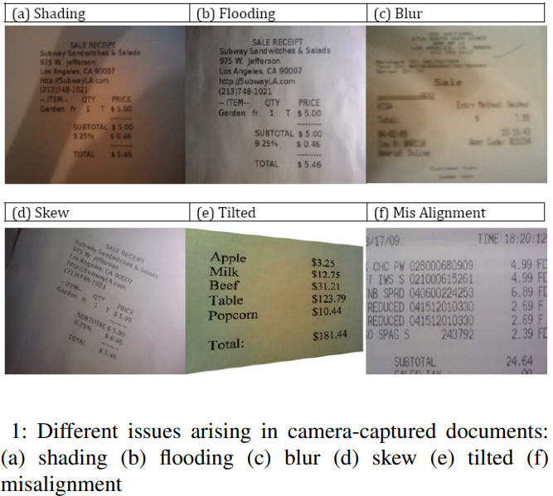
Common issues in camera-captured images

Slide 5
Proposed Implementations
Firebase OCR Implementation:
Firebase ML Toolkit
https://github.com/davoidadmin/FirebaseOCR
Tesseract OCR Implementation:
Tesseract API
Text-to-Speech API
https://github.com/davoidadmin/TesseractOCR

Slide 6

Firebase OCR
Firebase ML Kit is a powerful mobile SDK provided by Google that enables developers to integrate machine learning capabilities into their Android applications without requiring extensive knowledge of machine learning algorithms.
One of the key features of Firebase ML Kit is its support for Optical Character Recognition (OCR), which allows developers to extract text from images.
Firebase ML Kit's OCR API provides a simple and intuitive interface for developers to integrate text recognition into their apps. It offers options to detect and recognize text in real-time from live camera input or to process static images. The API also supports language detection, enabling multilingual OCR capabilities.
Additionally, Firebase ML Kit's OCR functionality provides robust text recognition even in challenging conditions, such as low light, skewed angles, or complex backgrounds. It also supports text recognition in different languages and provides flexibility in customizing recognition settings to meet specific application requirements.

Slide 7
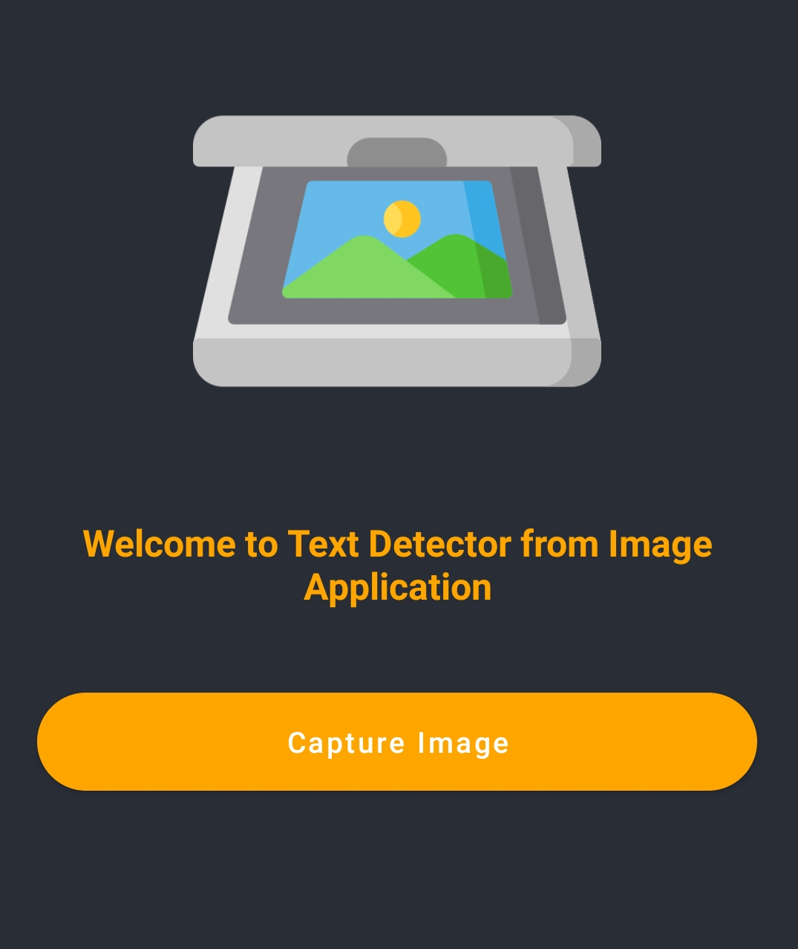
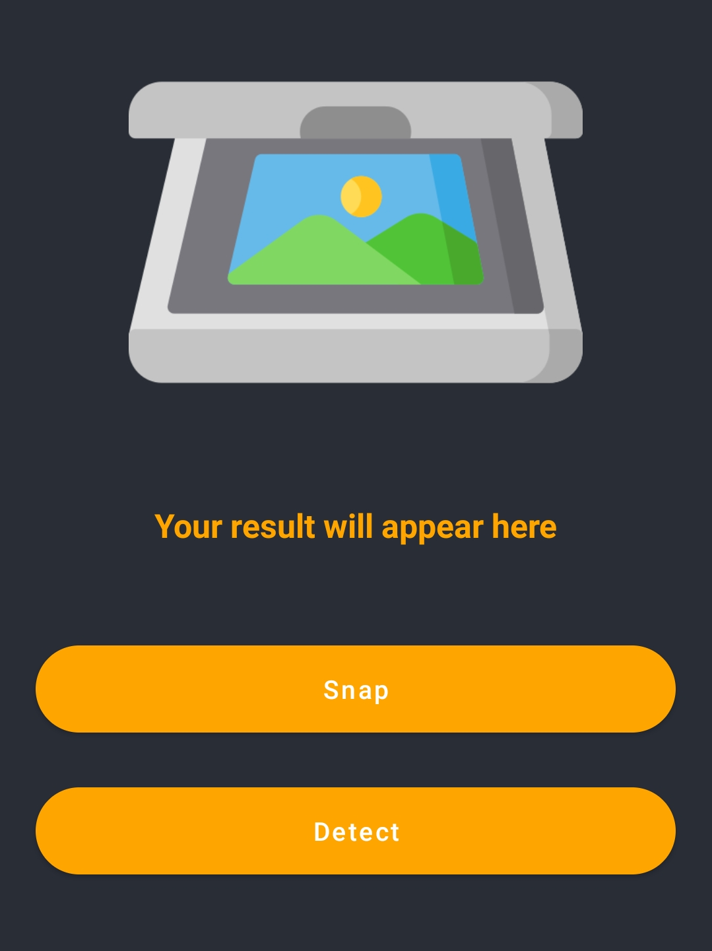

Firebase OCR

Slide 8
Firebase OCR
Capture Image:
Handles Camera Permissions
Snap:
Opens Phone Camera
Archives Picture
Detect:
Performs OCR
(TextRecognizerAPI)
Shows result string on screen

Slide 9

Tesseract OCR
Initially released as a proprietary software by Hewlett-Packard Laboratories, Tesseract OCR transitioned into an open-source project, allowing developers worldwide to contribute to its evolution. Currently maintained and supported by the open-source community, Tesseract OCR benefits from the collective expertise and continuous improvements driven by a diverse group of contributors.
One of the notable features of Tesseract OCR is its exceptional accuracy in recognizing text from images. It can effectively handle various languages, font styles, and complex document layouts, making it suitable for a wide range of applications.
Provides extensive language support through its language data files, enabling precise recognition and extraction of text in different languages.
Its performance is optimized to deliver fast and accurate results, even in challenging scenarios involving low-resolution images or poor-quality scans.

Slide 10
Tesseract OCR
Text-to-Speech API:
Text-to-Speech (TTS) is a technology that converts written text into spoken words. It enables computers and software applications to generate human-like speech, allowing users to listen to text content rather than reading it. TTS APIs provide developers with the tools and resources to integrate this functionality into their applications, opening up a range of possibilities for enhancing accessibility, user experience, and communication.
Modern TTS APIs utilize deep learning models and neural networks to create more natural and expressive speech, mimicking the nuances of human language and intonation. This has led to significant improvements in speech quality and the overall user experience.
The applications of TTS API are vast and diverse. They can be integrated into various domains and industries to provide value-added functionalities. Some common use cases include Accessibility, Language Learning, Assistive Technologies and Entertainment.
By leveraging a Text-to-Speech API, developers can harness the power of speech synthesis to create inclusive, engaging, and interactive applications that cater to a broader audience and deliver information in a more accessible and convenient format.

Slide 11
Tesseract OCR
Capture Image:
Handles Camera Permissions
Opens Phone Camera
Perform OCR:
Performs OCR through TesseractOCR API
Shows result string on Screen
Read Text:
Reads the obtained string through TTS API

Slide 12
Conclusions
Let’s now make a comparison between the implemented tools to understand which one is the best candidate to reach our goal.
Firebase ML Kit and Tesseract OCR are both popular tools for implementing Optical Character Recognition in mobile applications. However, they have distinct characteristics that make them suitable for different use cases. When considering the app UI to be completely vocal assistant-driven,to help visually impaired individuals, there are several pros and cons to consider for each solution:

Slide 13
Conclusions
Pros:
Integration with other Firebase services.
Cloud-based OCR
Wide language support
Continuously updated models
Cons:
Internet dependency
Pricing considerations

Slide 14
Conclusions
Pros:
Open-source and free
Offline functionality
Community support
On-device processing (no need for network & latency reduction)
Cons:
Limited language support
Development complexity (Developers need to handle the implementation details, training data, and preprocessing of images for optimal OCR results)

Slide 15
Conclusions
Considering our goal, Tesseract OCR may be a better fit due to the following reasons:
Offline functionality;
Control and customization;
Community support
However, it's worth noting that Firebase ML Kit's cloud-based OCR can offer more robust OCR capabilities and continuous model improvements, which might be advantageous in scenarios where internet connectivity is reliable and extensive language support is critical.
Ultimately, the choice between Firebase ML Kit and Tesseract OCR depends on the specific needs and constraints of the application. Considering the vocal assistant-driven UI and accessibility for visually impaired users, Tesseract OCR's offline functionality and customization options make it a stronger candidate.

